Slide 1
Overview
Data Preparation & Corpus
Model Creation & Encoding
Experiments & Analysis
Download data from primary sources
Cleanse it/manipulate it
Extract pertinent information
proteins
pfam entries
disorder regoins
taxonomy
Combine data from previous step into a set of ‘sentences’ that can be passed to a model
Repeat for different parameters:
Create word2vec models based upon the corpus
Repeat for each model:
Encode pfam entries into vector representation
Create distance matrix between pairs of fam vectors
Analyse data
Input
Raw data from various websites
Output
DAT files (tab delimited)
Database tables
Input
DAT files from previous step
Database from previous step
Output
Set of sentences for each protein, each sentence consisting of words representing the protein in question
PFAM ENTRY
DISORDER REGION
Input
Sentences from previous step (ie the corpus)
Output
A set of models for various word2vec configurations
Encodings for each pfam entry
Distance matrix for each pfam entry to each other and for each model
Input
XX
Output
XX

Slide 2


95M Eukaryotic Proteins
300M
Pfam entries
Data Cleansing & Corpus Preparation
corpus
46M
sentences
144 word2vec models
Disorder 4BN lines

Slide 4
RAW DATA
DATA
CLEANSE
DAT FILES
DATABASE
LOAD
proteins
proteins
protein families
disorder regions

Slide 5
Example : Protein A8KBH6
Unique Identifier for a protein
>UniRef100_Q6GZX4 Putative transcription factor 001R n=4 Tax=Ranavirus TaxID=10492 RepID=001R_FRG3G
MAFSAEDVLKEYDRRRRMEALLLSLYYPNDRKLLDYKEWSPPRVQVECPKAPVEWNNPPS
EKGLIVGHFSGIKYKGEKAQASEVDVNKMCCWVSKFKDAMRRYQGIQTCKIPGKVLSDLD
AKIKAYNLTVEGVEGFVRYSRVTKQHVAAFLKELRHSKQYENVNLIHYILTDKRVDIQHL
EKDLVKDFKALVESAHRMRQGHMINVKYILYQLLKKHGHGPDGPDILTVKTGSKGVLYDD
SFRKIYTDLGWKFTPL
Amino Acid sequence
Unique Identifier for a protein
Unique Identifier for a protein family (pfam)
Start and end positions of the pfam item within the protein sequence
A0A001 IPR011527 ABC transporter type 1, transmembrane domain PF00664 17 276
A0A001 IPR011527 ABC transporter type 1, transmembrane domain PS50929 17 289
A0A001 IPR017871 ABC transporter-like, conserved site PS00211 478 492
A0A001 IPR027417 P-loop containing nucleoside triphosphate hydrolase G3DSA:3.40.50.300 341 573
A0A001 IPR027417 P-loop containing nucleoside triphosphate hydrolase SSF52540 342 565

Slide 6
Unique Identifier for a protein
<protein id="A0A0B1TV04" name="A0A0B1TV04_OESDE" length="107" crc64="DD962B54888583AE">
<match id="mobidb-lite" name="disorder_prediction" dbname="MOBIDBLT" status="T" model="mobidb-lite" evd="MobiDBlite">
<lcn start="1" end="25" sequence-feature="Polyampholyte"/>
<lcn start="1" end="38" sequence-feature="Consensus Disorder Prediction"/>
<lcn start="78" end="107" sequence-feature="Consensus Disorder Prediction"/>
start and end position of the disorder region on the protein sequence
A dbname of ‘MOBIDBLT’ indicates that this entry is for a disorder region

Slide 7
vpc : w2-dev-vpc
w2v-igw
subnet : w2-dev-subnet : 10.0.0.0/16
EC2
RDS
security group : w2v_security_group
Ingress from 0.0.0.0/0:
HTTP
HTTPS,
3306
Egress: All TCP

Slide 8




Data Preparation – From raw downloads to database
UniProt Website
XXX Website
Website
95M Eukaryotic
proteins - UniRef100
78M Eukaryotic proteins - TrEMBL
protein2ipr.dat
extract pfam entries only
database import
database import
extra.xml
database import
protein2ipr_pfam.dat
W2V_UNIREF100_PROTEIN_E
W2V_PROTEIN
W2V_TOKEN
COUNTER
UNIPROT_ID
LEN
START
END
N_MEMBERS
TAX_ID
TAX_NAME
UNIPROT_ID
START
END
UNIPROT_ID
TYPE
TOKEN
START
END
Eukaryotic proteins only but TrEMBL - excludes
Note: W2V_TOKEN has all pfam entries from protein2ipr.dat – thus includes more than eukaryotic
Also contains all disorder entries irrespective of the protein
Eukaryotic proteins only but UNiRef100 – includes taxonomy
Note: adding a COUNTER (integer increasing from 0) significantly increase the ability to select chunks of data as you can do it using > and <= clauses within the select statement
W2V_TAX_CAT
W2V_TAX_NAME
UNIPROT_ID
TYPE
TOKEN
START
END
UNIPROT_ID
TYPE
TOKEN
START
END
NCBI Website
convert to dat

Slide 9
Data Preparation – Getting pfam ids for eukaryotic proteins
W2V_UNIREF100_PROTEIN_E
COUNTER
UNIPROT_ID
LEN
START
END
N_MEMBERS
TAX_ID
TAX_NAME
SELECT W2V_PROTEIN_UREF100_E.UNIPROT_ID, W2V_TOKEN.TOKEN FROM ( SELECT UNIPROT_ID FROM W2V_PROTEIN_UREF100_E WHERE COUNTER >= {start_pos} and COUNTER < {end_pos}) AS W2V_PROTEIN_UREF100_E INNER JOIN W2V_TOKEN AS W2V_TOKEN ON W2V_PROTEIN_UREF100_E.UNIPROT_ID = W2V_TOKEN.UNIPROT_ID WHERE W2V_TOKEN.TYPE = 'PFAM'
W2V_TOKEN
UNIPROT_ID
TYPE
TOKEN
START
END

Slide 10
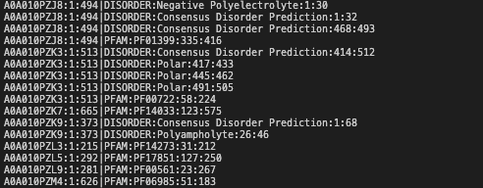
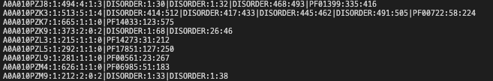

From Database to Corpus
1. Extract tokens and disorder regions from database
2. Convert raw SQL output to csv
AWS
W2V_TOKEN
!
W2V_PROTEIN
UNIPROT_ID
START
END
UNIPROT_ID
TYPE
TOKEN
START
END
RDS
extract_tokens_from_db.sh
convert_db_tokens_dat.sh
sql_output_00M_00.dat > sql_output_70M_16.dat
EC2
sql output (on AWS)
combine_db_tokens_dat.sh
3. Create pre-corpus
one row per token that exists for each protein in W2V-PROTEIN where tokens are pfam entries or disorder regions
precorpus_00M_00.dat > precorpus _70M_16.dat
protein id : start : end : num tokens : num pfam tokens : num disorder tokens
4. Create corpus
create_corpus.py
MySQL Python library was too slow – had to revert to raw SQL on the server
Had to do queries in chunks of 100K (after some experimentation)
Thus, ended up with 157 files of SQL output – each with 100k worth of protein tokens
Also not possible to avail of the formatting tools to save to a file locally so instead had to output raw sql to client command line this mandated another step – ie step 2, rather than being able to go from the database direct to pre-corpus in a single go
Also tried AWS Redshift and AWS Glue Data Crawlers but learning curve was too high and the pricing mechanism was not transparent enough

Slide 11
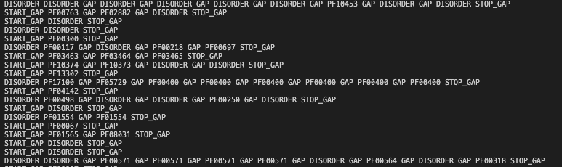


157 CORPUS FILES – ONE LINE PER EUKARYOTIC PROTEIN
157 files
load sentences
800s to load all 157 files on Macbook
w2v = Word2Vec (sentences, vector_size = vector_size, window = window_size, workers=4, epochs=10, min_count=5)
word2vec models
1976s v = 10, w = 5

Slide 12


Get word encodings
pfam encodings
model
pfam encoding matrix
unique pfam entries

